Slide 1
Fraud Transacation Detection

Slide 2
Objective:
Credit card frauds are easy and friendly targets. E-commerce and many other online sites have increased the online payment modes, increasing the risk for online frauds. Increase in fraud rates, researchers started using different machine learning methods to detect and analyse frauds in online transactions. The main aim of the paper is to design and develop a novel fraud detection method for Transaction Data, with an objective, to analyse the past transaction details of the customers and extract the behavioural patterns.

Slide 3
Introduction:
Credit card generally refers to a card that is assigned to the customer (cardholder), usually allowing them to purchase goods and services within credit limit or withdraw cash in advance. Credit card provides the cardholder an advantage of the time, i.e., it provides time for their customers to repay later in a prescribed time, by carrying it to the next billing cycle.
Credit card frauds are easy targets. Without any risks, a significant amount can be withdrawn without the owner’s knowledge, in a short period. Fraudsters always try to make every fraudulent transaction legitimate, which makes fraud detection very challenging and difficult task to detect.
With different frauds mostly credit card frauds, often in the news for the past few years, frauds are in the top of mind for most the world’s population. Credit card dataset is highly imbalanced because there will be more legitimate transaction when compared with a fraudulent one.

Slide 4
Benefits:
Detection of frauds.
Analyse the past transaction details of the customers and extract the behavioural patterns.
Easily evaluate transaction is fraud or not

Slide 5
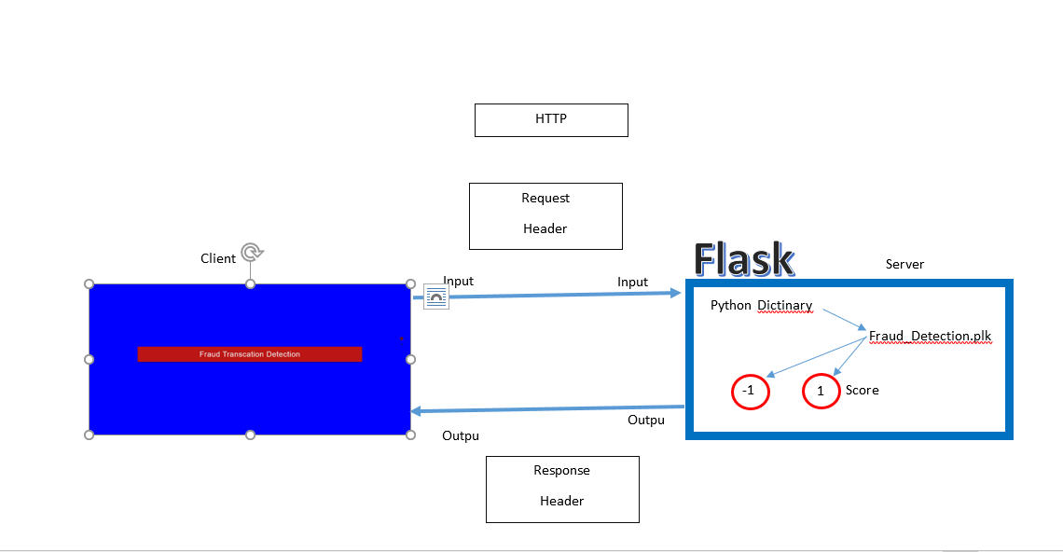
Architecture

Slide 6
Methodology:
Import all required libraries
Analysing Data
Vislalisiong the null values
Splitting data in Training and Testing sets
Feature scaling
KNN training
SVM training
Naive bayes training
Decision Tree training
Random forest training

Slide 7
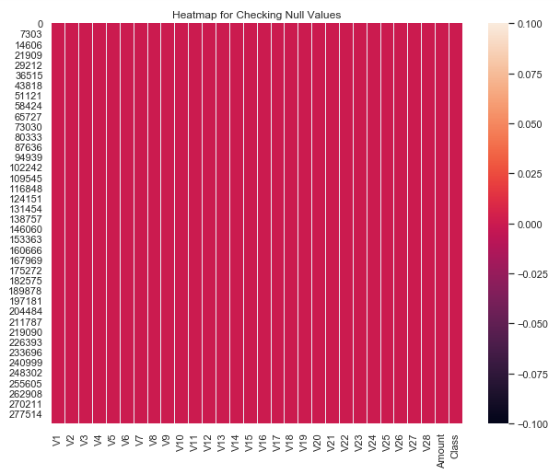
Visualizing the null values:

Slide 8
Model Training:
Data Export from Kaggle :
Data Preprocessing
Data Validation
Data Training

Slide 9
Model Selection –
By using algorithms “KNN”,“SVM” ,“Naïve bayes”, “Random Fores”. We calculate the scores for models and select the model with the best score. Similarly, the model is selected for each cluster. All the models for every cluster are saved for use in prediction

Slide 10
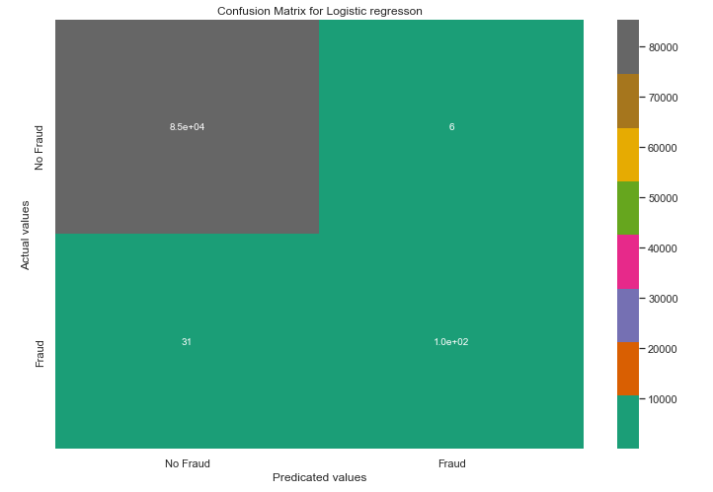
Prediction:
The testing files are shared in the batches and we perform the same Validation operations ,data transformation and data insertion on them.

Slide 11
Special Thanks- Sudhanshu,Krish , iNeuron support team
Deigned by- Mohammad Danish
Diksha Sharma
Nitin kushwaha

